Slide 1
Set 4

Slide 2

The pin is on.

Slide 3
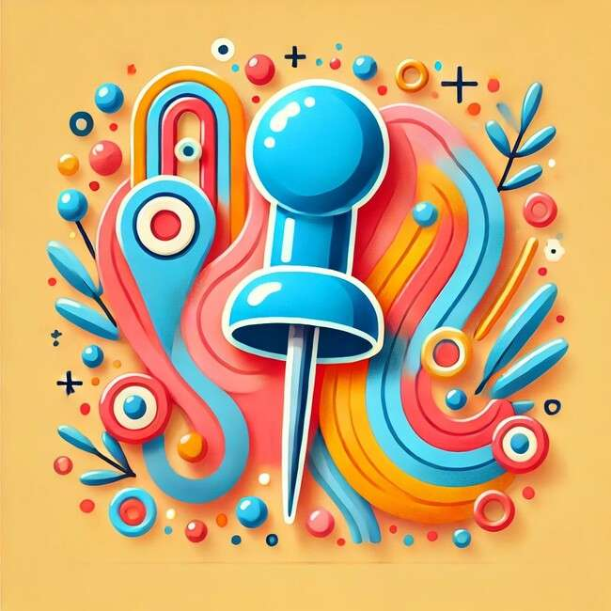
The pin is in.

Slide 4
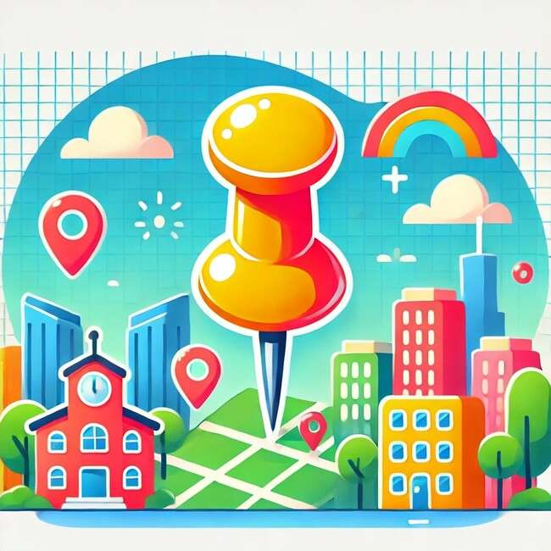
The pin is up

Slide 5
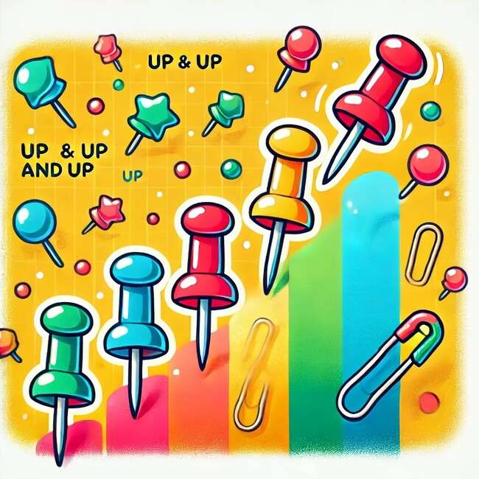
The pin is up and up and up

Slide 6

The pet is on.

Slide 7
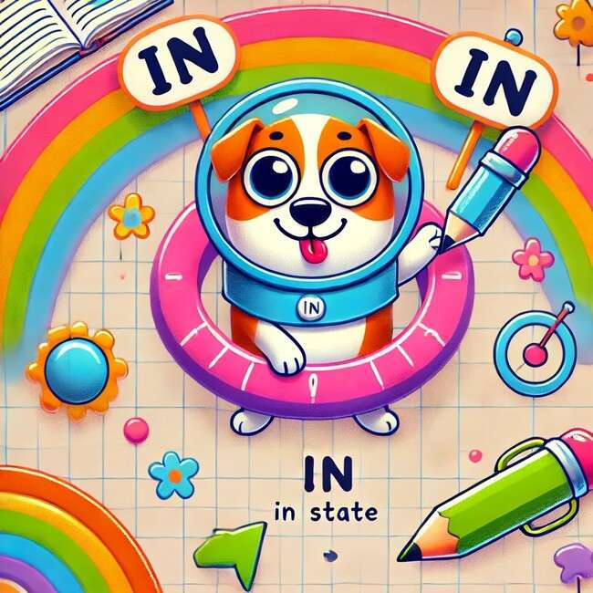
The pet is in.

Slide 8
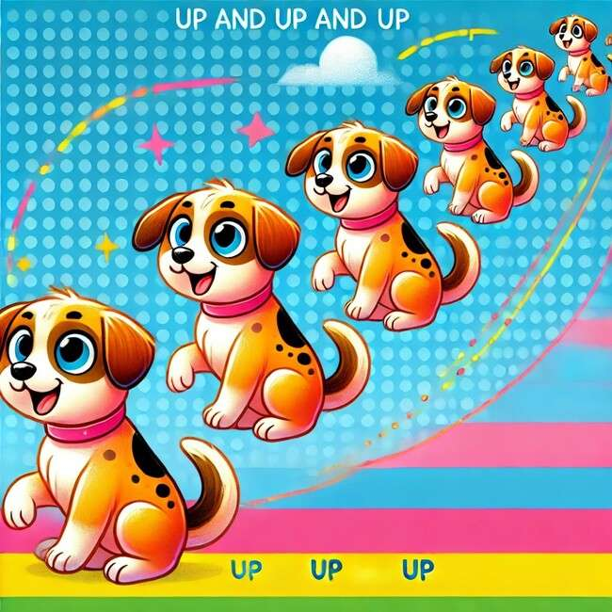
The pet is up and up and up.

Slide 9
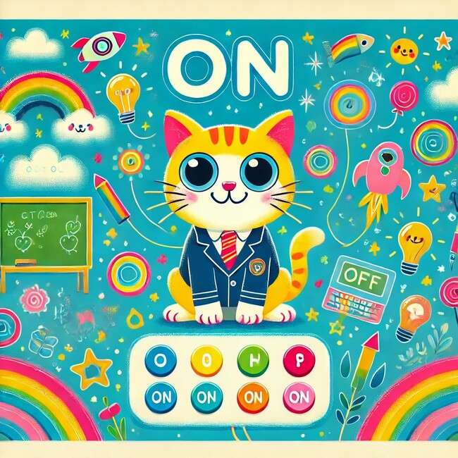
The cat is on.

Slide 10

The cat is in.

Slide 11
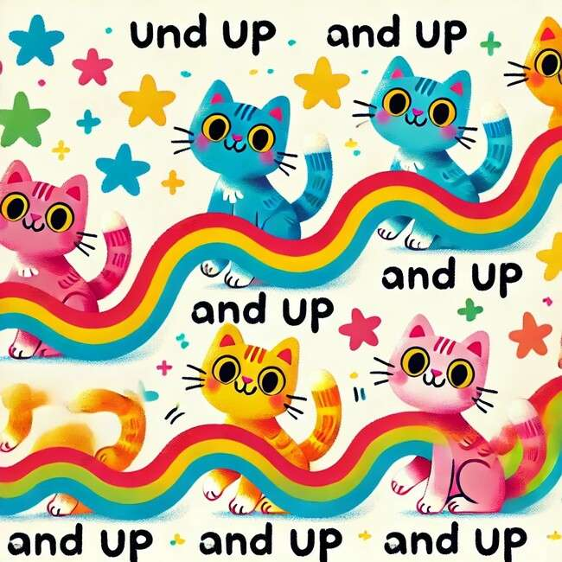
The cat is up and up and up.

Slide 12
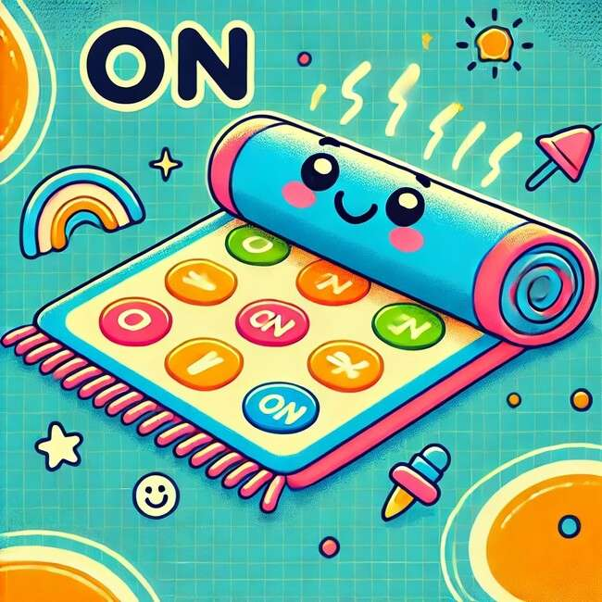
The mat is on.

Slide 13
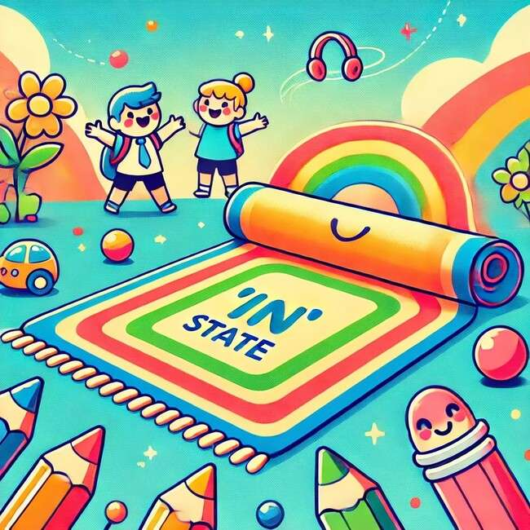
The mat is in.

Slide 14
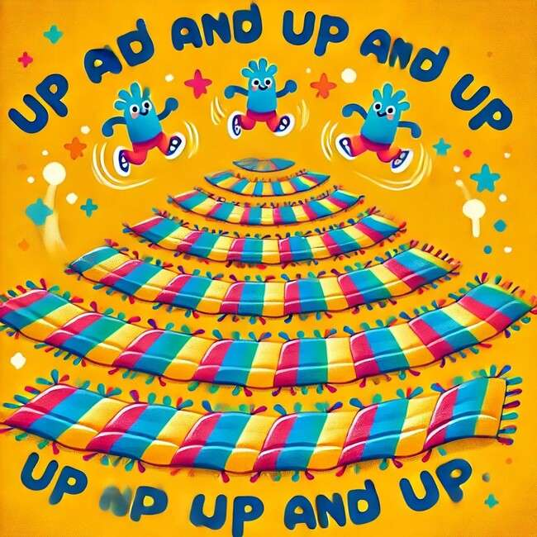
The mat is up and up and up.

Slide 15
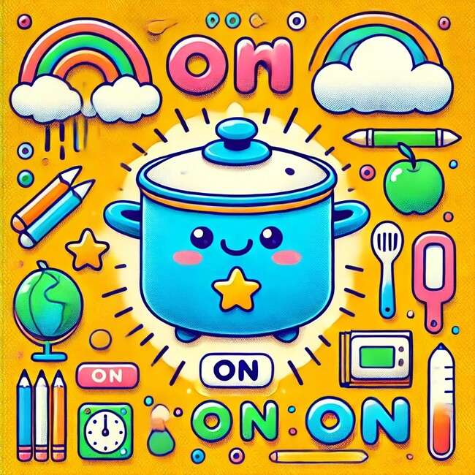
The pot is on.

Slide 16
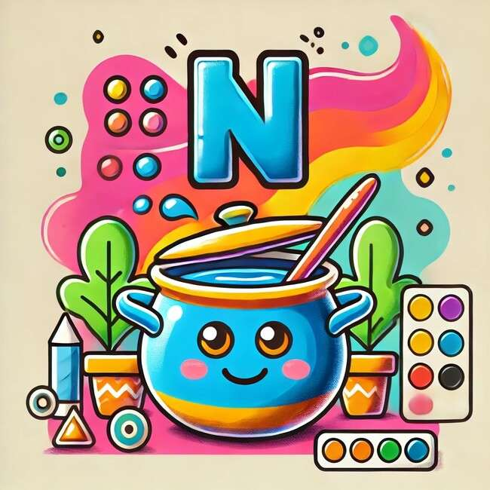
The pot is in.

Slide 17
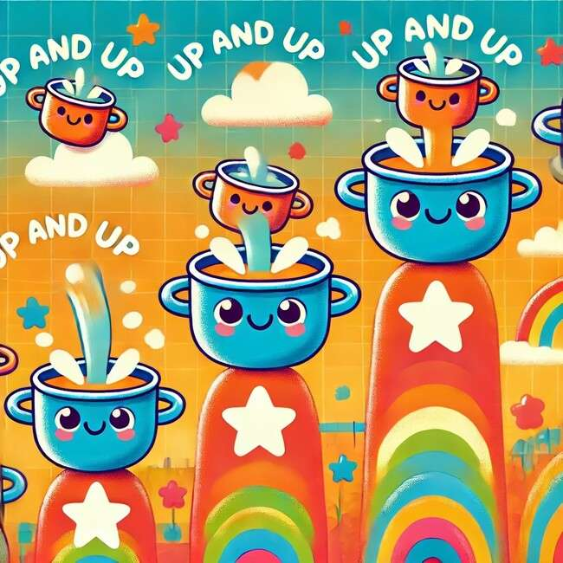
The pot is up and up and up.

Slide 18
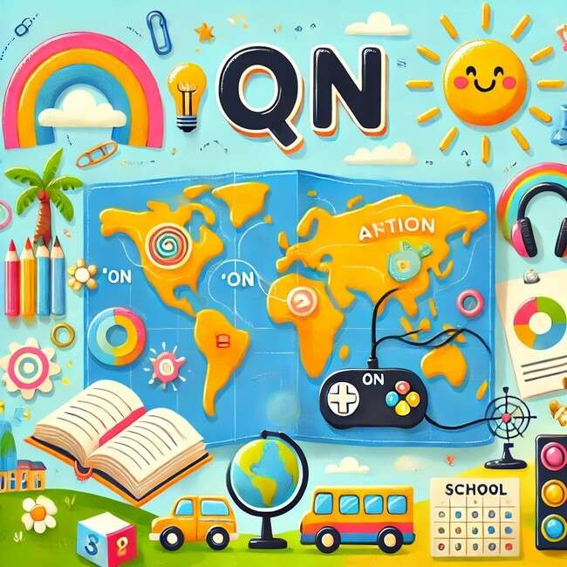
The map is on.

Slide 19
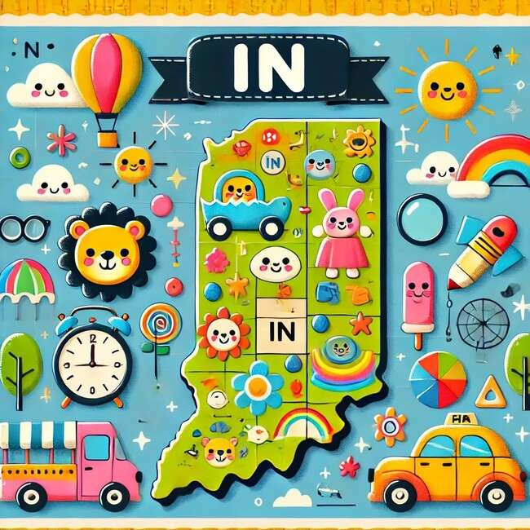
The map is in.

Slide 20
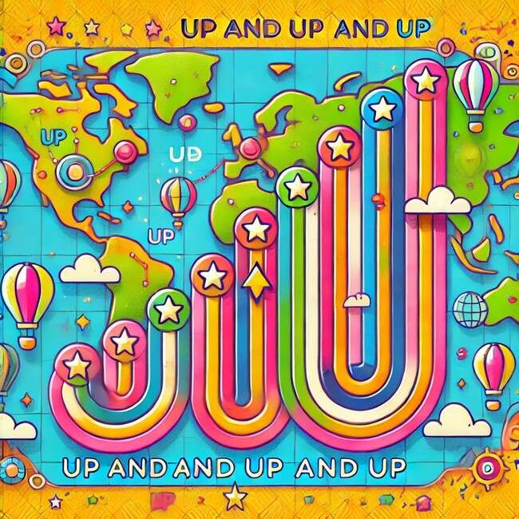
The map is up and up and
up.

Slide 21
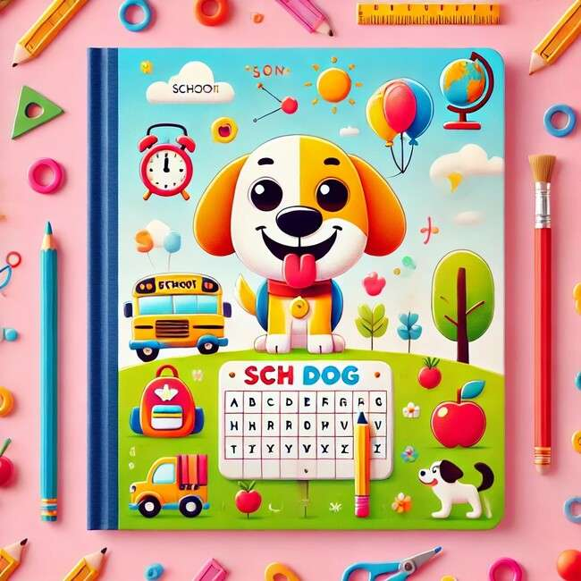
The dog is on.

Slide 22

The dog is in.

Slide 23
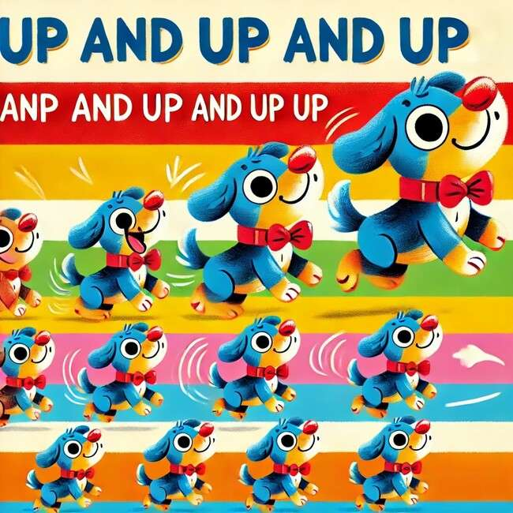
The dog is up and up and up.

Slide 24

The dot is on.

Slide 25

The dot is in.

Slide 26
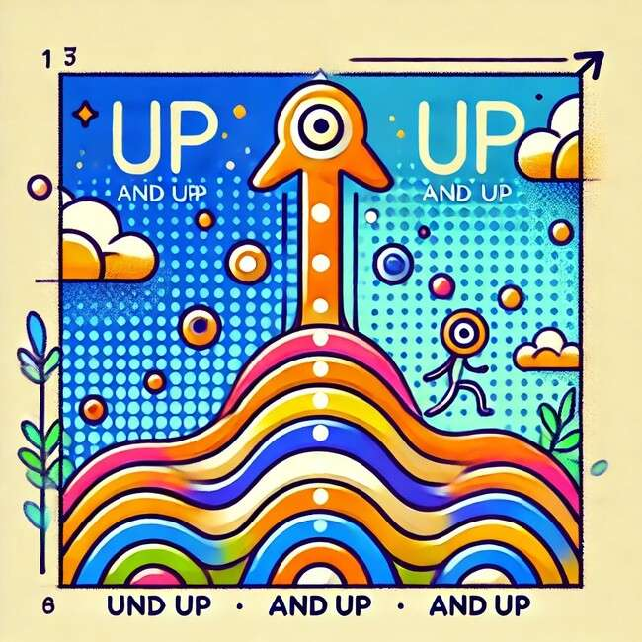
The dot is up and up and up.

Slide 27
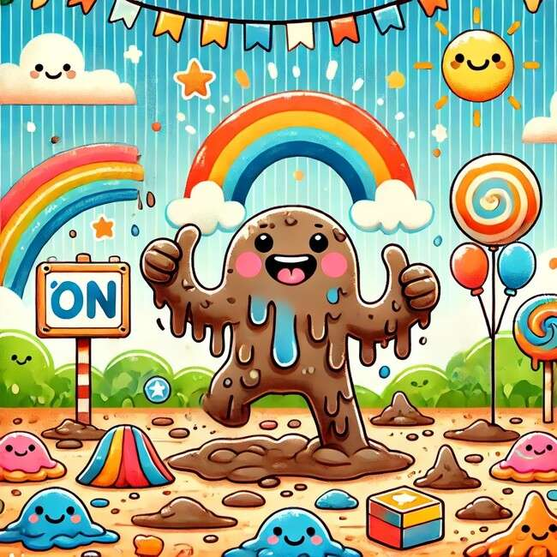
The mud is on.

Slide 28
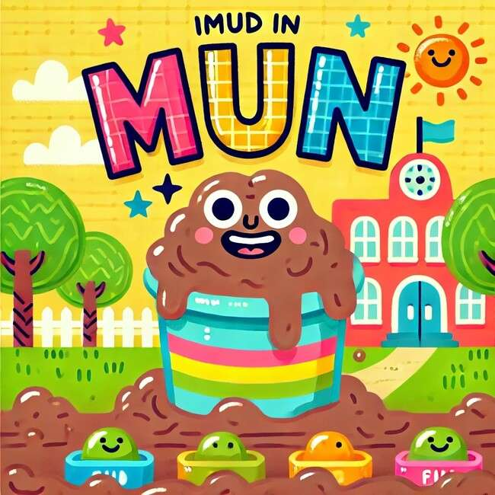
The mud is in.

Slide 29
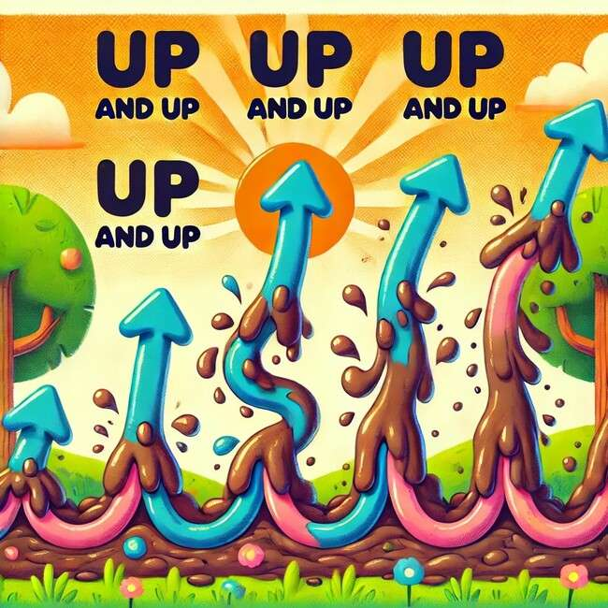
The mud is up and up and up.

Slide 30
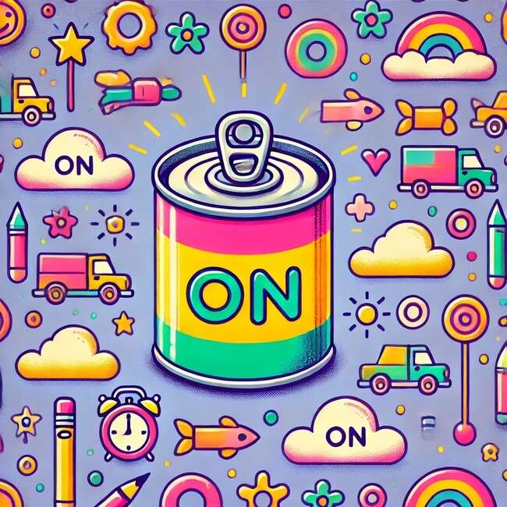
The Tin is on.

Slide 31
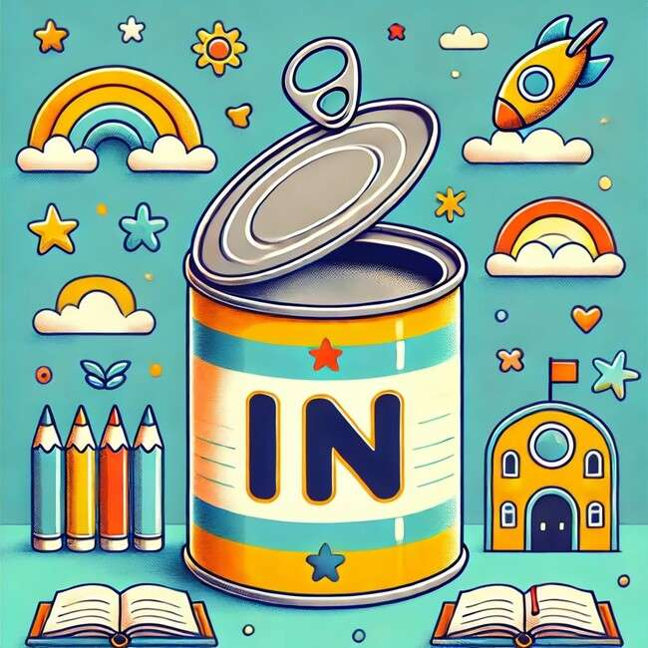
The tin is in.

Slide 32
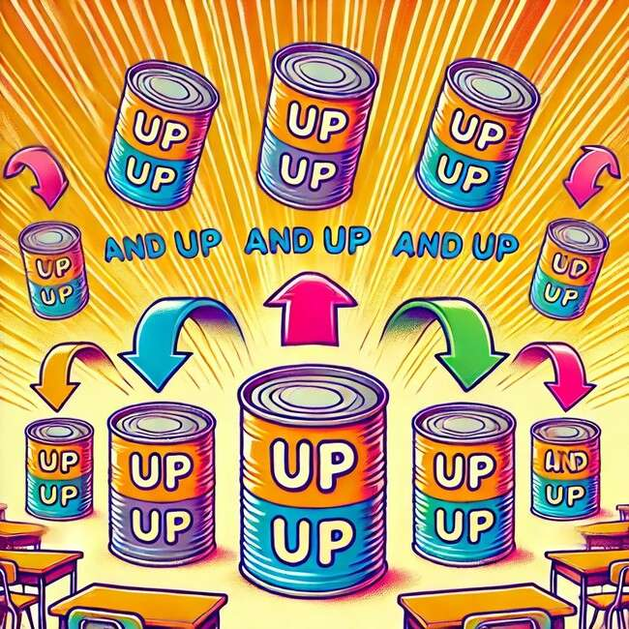
The tin is up and up and up.

Slide 33
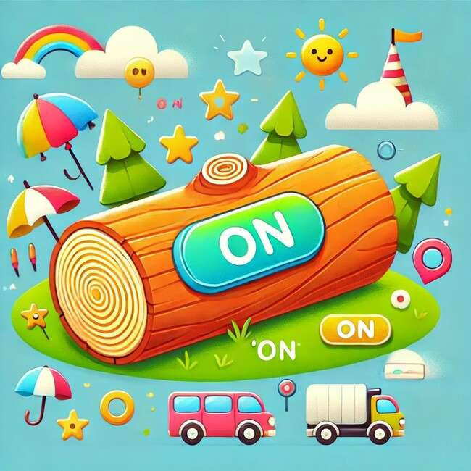
The log is on.

Slide 34
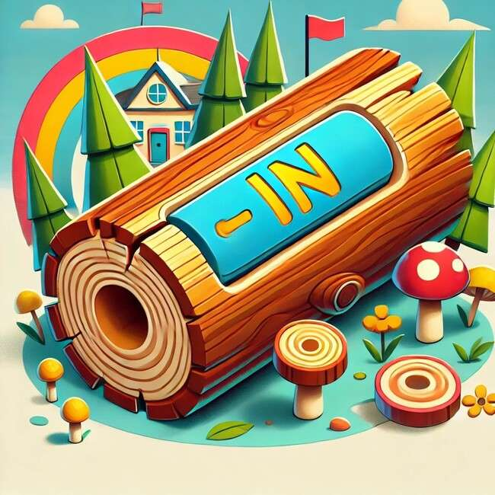
The log is in.

Slide 35
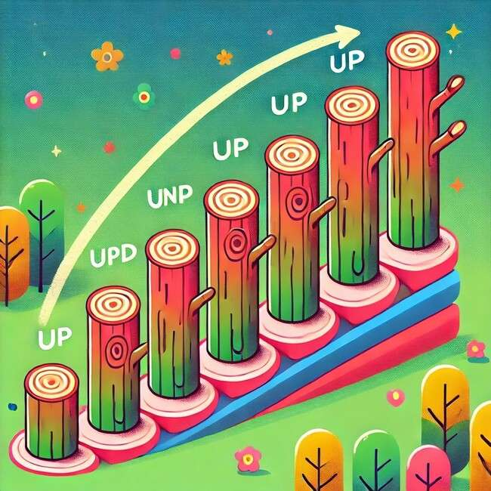
The log is up and up and
up.

Slide 36
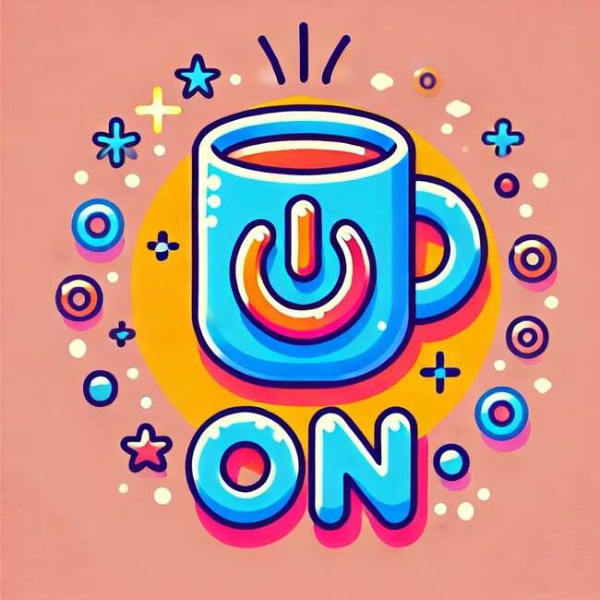
The cup is on.

Slide 37

The cup is in.

Slide 38
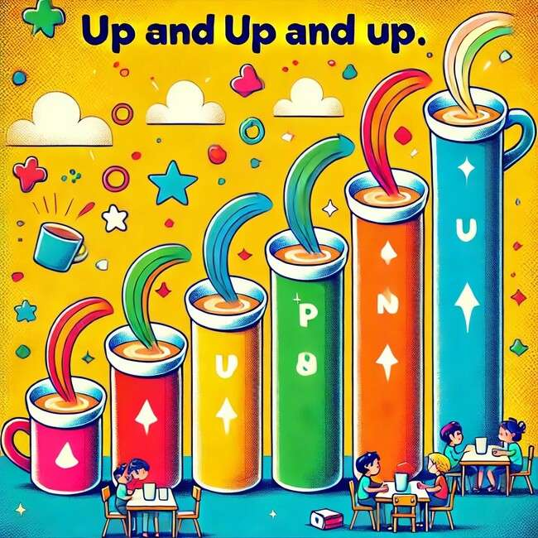
The cup is up and up and up.

Slide 39
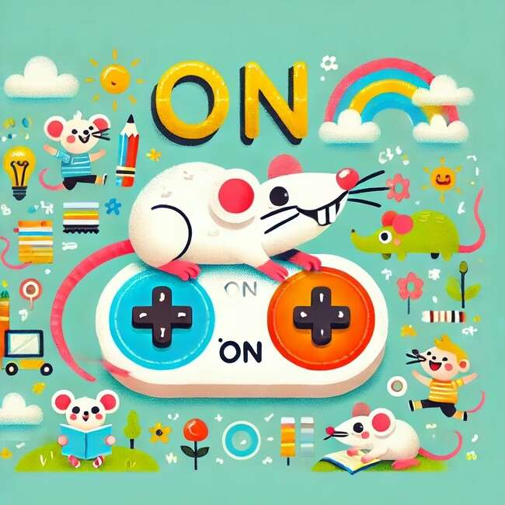
The rat is on.

Slide 40
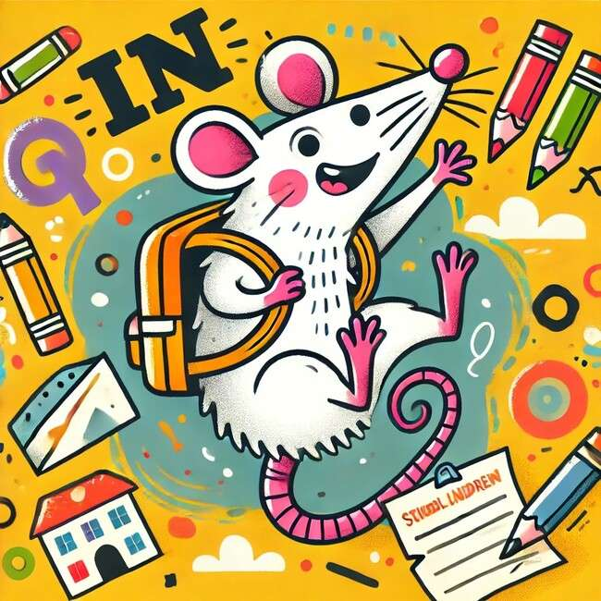
The rat is in.

Slide 41
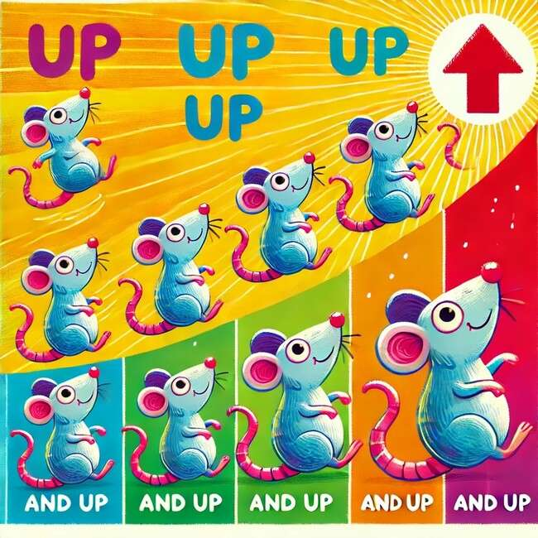
The rat is up and up and up.

Slide 42
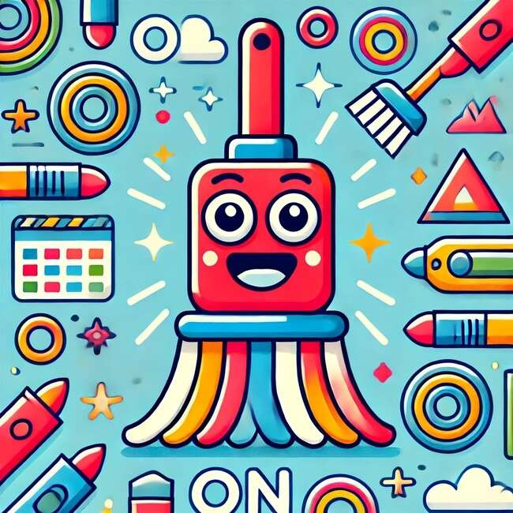
The mop is on.

Slide 43
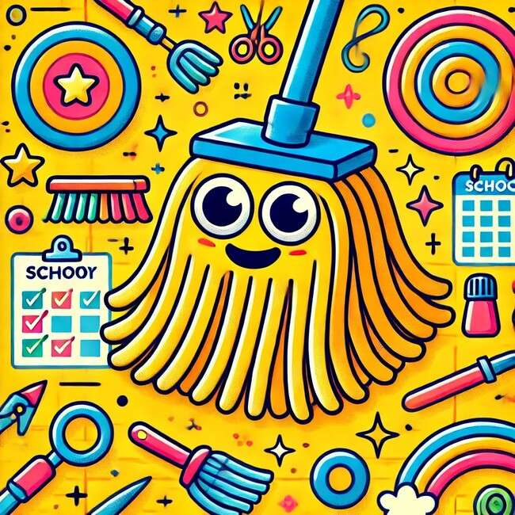
The mop is in.

Slide 44
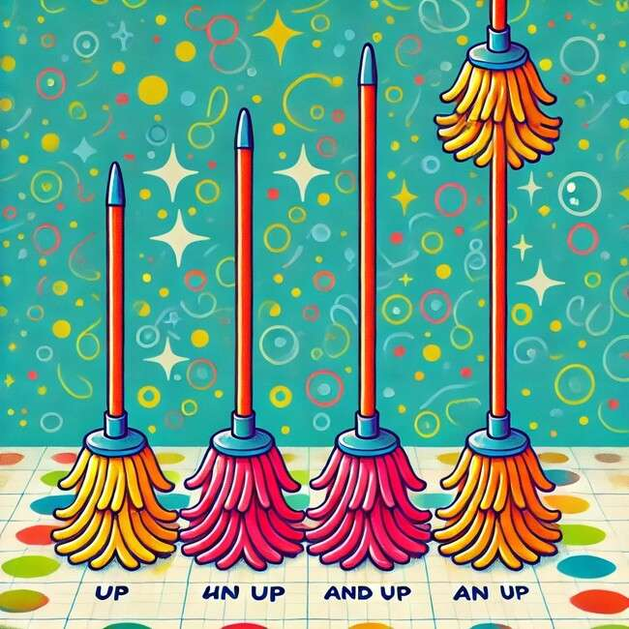
The mop is up and up and
up.

Slide 45
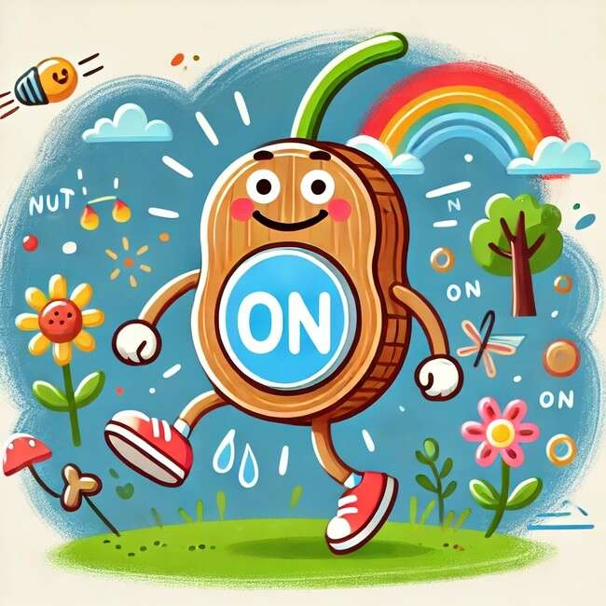
The nut is on.

Slide 46
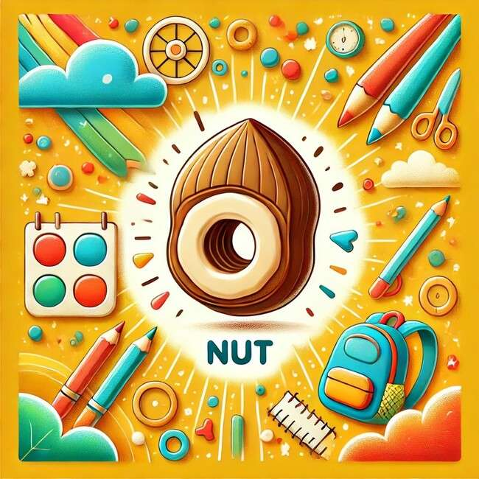
The nut is in.

Slide 47
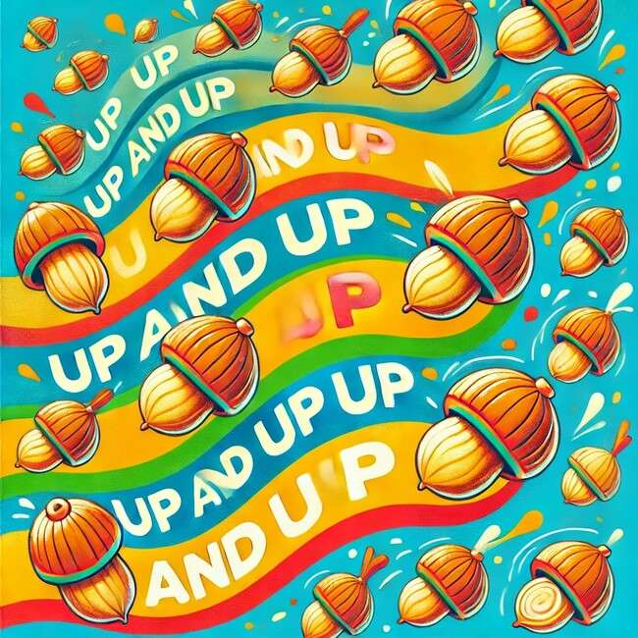
The nut is up and up and up.

Slide 48

The web is on.

Slide 49
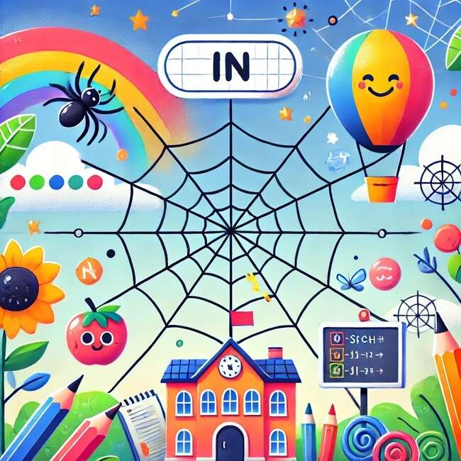
The web is in.

Slide 50
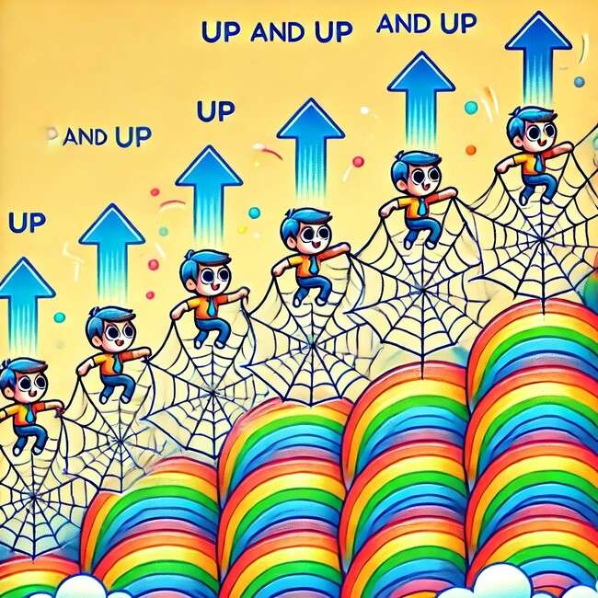
The web is up and up and up.

Slide 51
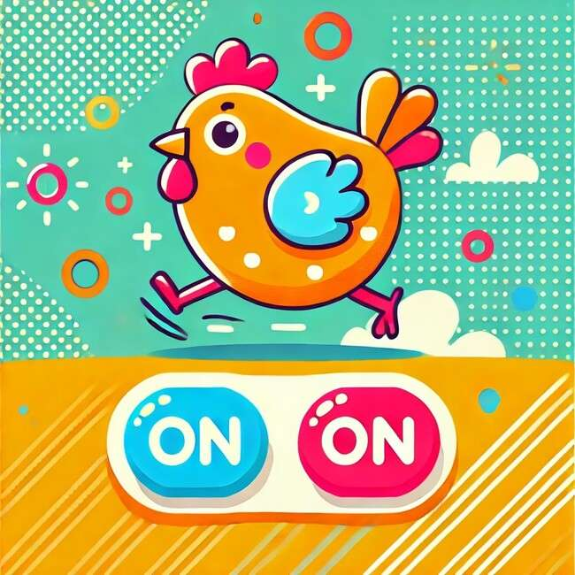
The hen is on.

Slide 52

The hen is in.

Slide 53
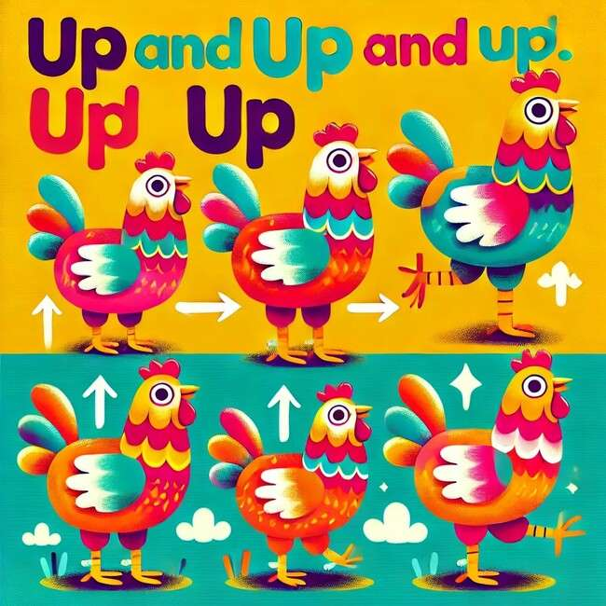
The hen is up and up and up.

Slide 54
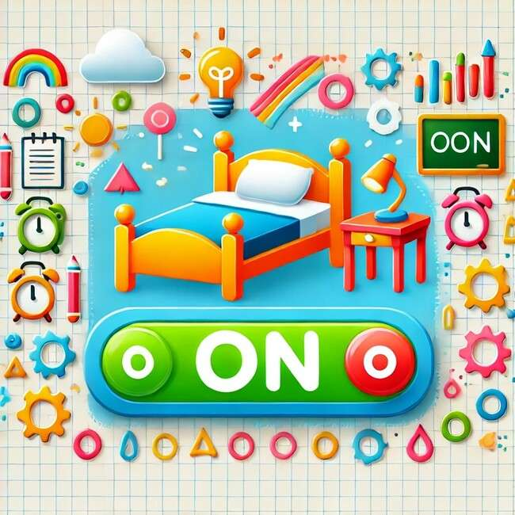
The bed is on.

Slide 55
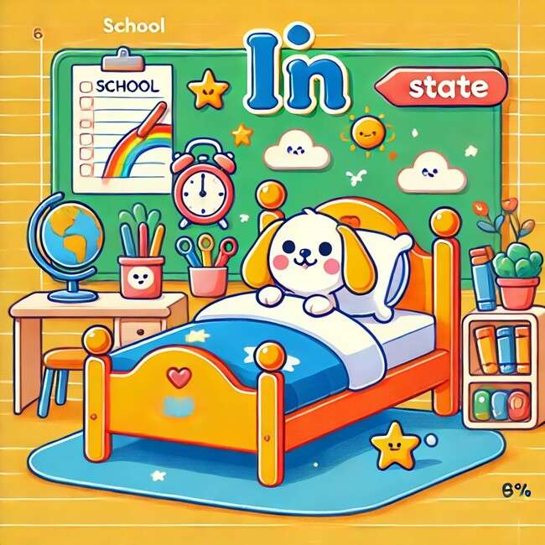
The bed is in.

Slide 56
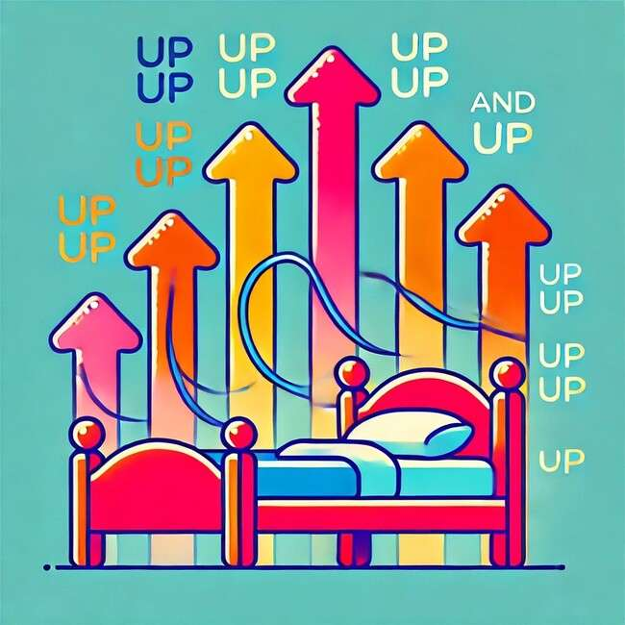
The bed is up and up and up.

Slide 57

The bag is on.

Slide 58

The bag is in.

Slide 59
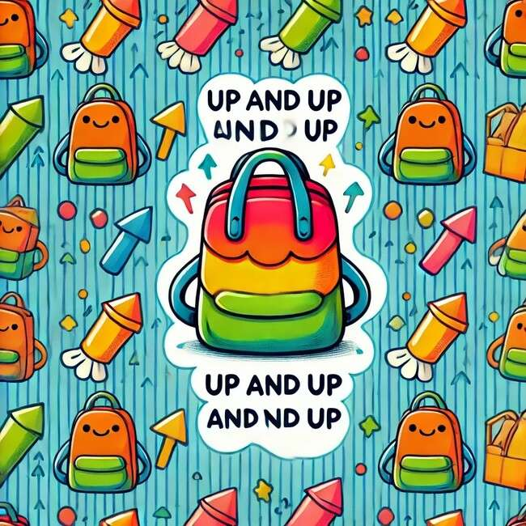
The bag is up and up and up.

Slide 60
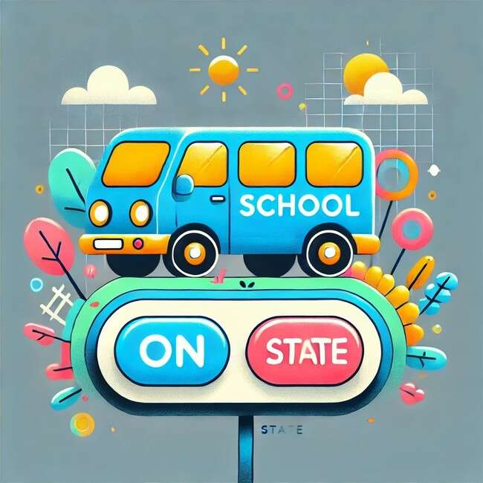
The van is on.

Slide 61
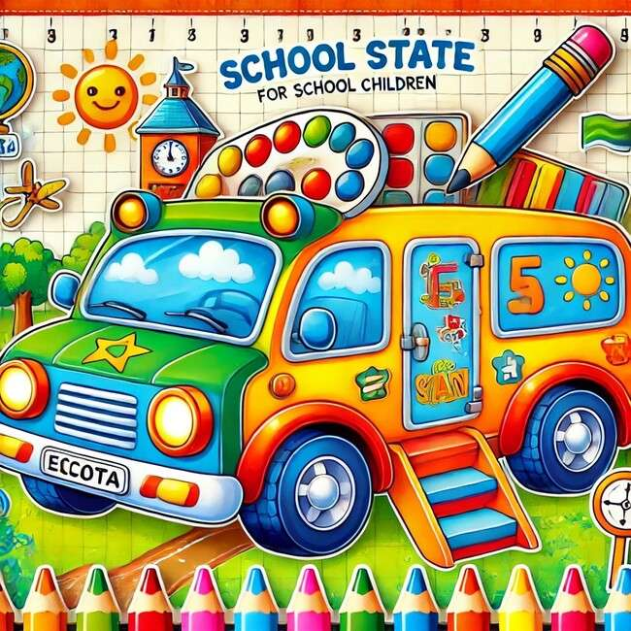
The van is in.

Slide 62
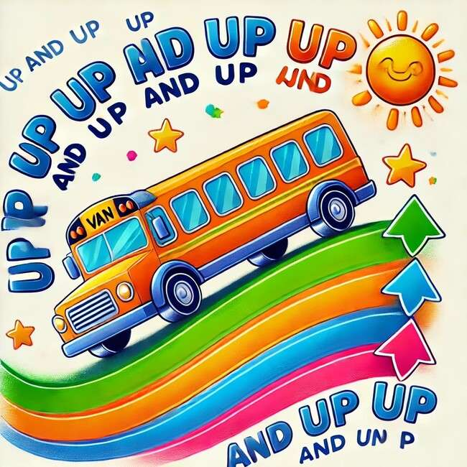
The Van is up and up and up.

Slide 63

The bus is on.

Slide 64

The bus is in.

Slide 65

The Bus is up and up and up.

Slide 66

The Pig is up and up and up.

Slide 67
Reference
OpenAI. (2025). SET 1 design concept [AI-generated image]. DALL·E. Retrieved from [OpenAI Platform] https://chatgpt.com/c/6758dd08-22e0-8005-8145- 9e9ed9217e16
OpenAI. (2025). SET 1: An educational design with vibrant geometric patterns
[AI-generated image]. https://www.meta.ai/

